Slide 1
What is a Climate Assembly?

Slide 2
Purpose
To introduce the key features of Climate Assemblies
To discuss the reasons for running a Climate Assembly
To answer your questions

Slide 3
Agenda
16.00-16.05: Introduction
16.05-16.20: What is a Climate Assembly?
16.20-16.25: Why run a Climate Assembly?
16.25-16.40: Insights from Kelly McBride and Kaela Scott
16.40-16.55: Q&A

Slide 4
What is a Climate Assembly?
A process that brings together randomly selected everyday people to learn, deliberate and make recommendations for how to deal with climate change – initiated and commissioned by public authorities or civil society organisations.

Slide 5
Key features
Design
Implementation
Follow up
Framing of task and topic
Political commitment
Governance structure
Participant recruitment
Process design
Communication Strategy
Deliberation
Expert input
Facilitation
Recommendations
Political response
Evaluation
Notes:
Her er et overblik over key features.
Der er som man kan se meget at holde styr på – vi dykker ned i det meste i det følgende.
Det vigtigste her er at forstå, at der er et før, under og efter, og at der forskellige elementer, der hører til de forskellige faser

Slide 6
Tasks for Climate Assemblies
“How do we get to net zero by 2050?”
“Discuss dilemmas related to the green transition that are near to the citizens and to give recommendations for the climate action plans”
”A safer and fairer Spain in the face of climate change How do we do it?”
“Consider how to prevent or minimise, or remedy or mitigate the effects of, climate change [and] make recommendations on measures proposed to achieve the emissions reduction targets”
”Define a series of measures that will allow to achieve a reduction of at least 40% in greenhouse gas emissions by 2030 (compared to 1990) in a spirit of social justice”
Notes:
Borgertinget formål/opgave – hvorfor?

Slide 7
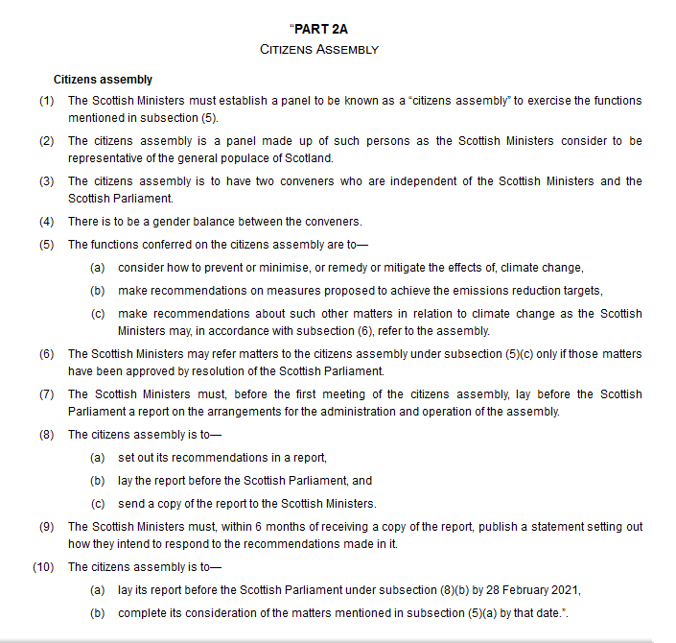
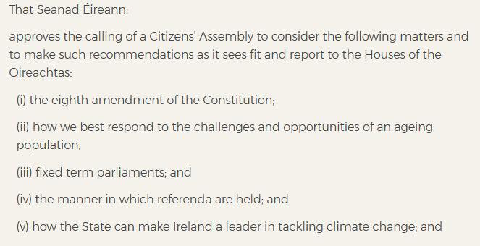
Political commitment
From the resolution on the Irish Citizens’ Assembly
From The Scottish Climate Act
Notes:
Borgetingets rolle – hvordan forholder det sig til de repræsentative institutioner? Overlapper med formålet

Slide 8
Governance structure and key groups involved
Citizens’ Assembly
Expert Panels
Commissioners
Secretariat / delivery team
Advisory Board
Observers
Steering Group

Slide 9
Process
Random selection of everyday people
Assembly meetings
Government or Parliament
Producing recommendations

Slide 10
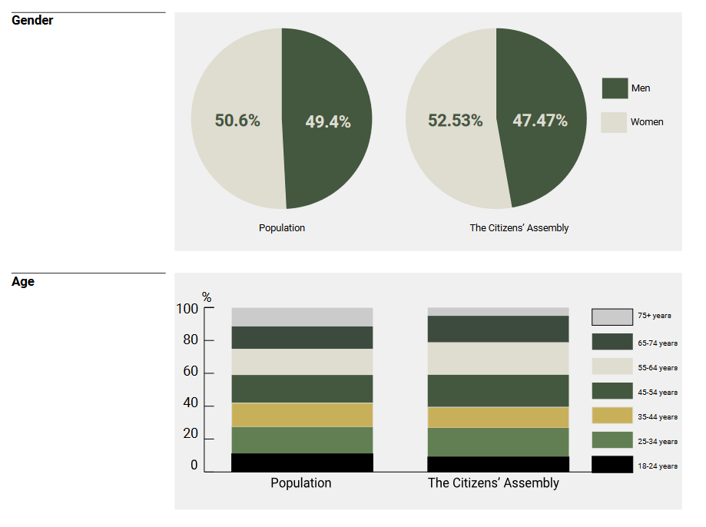
Random selection
Invitations
Random selection
Geography
Examples from the Danish Climate Assembly

Slide 11
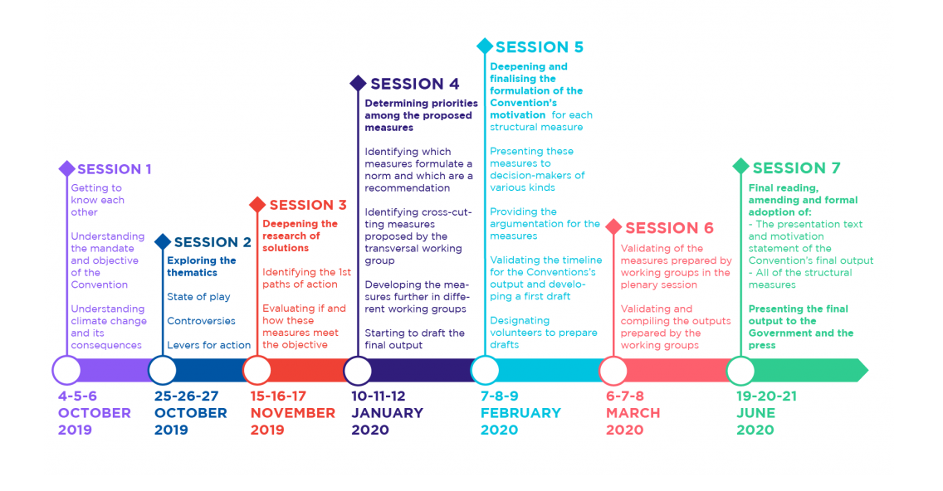
Assembly meetings (1/2)
Schedule: French Climate Convention
Learning
Deliberation
Decision-making
Schedule: The Danish Climate Assembly
Notes:
Learning: From intromaterial + dialogue with experts/ressource persons/witnesses
Deliberation: Among citizens
Decision-making: Deciding on recommendations

Slide 12
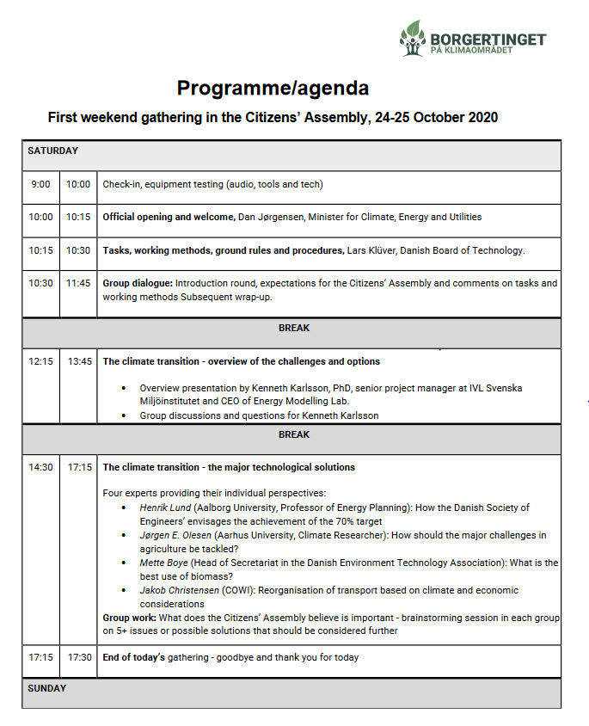
Assembly meetings (2/2)
Expert input
Deliberation
Facilitation
Agenda: The Danish Climate Assembly

Slide 13
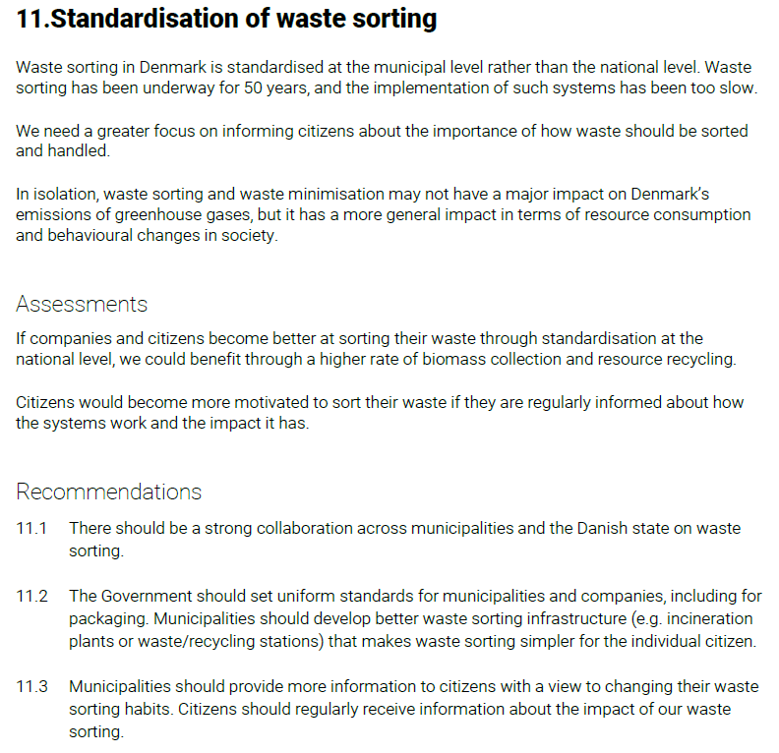
Recommendations – DK example
Themes
Popular education, behaviour and participation
Funding and levies
Agriculture, land and resources
Transport
Technical facilities in/as part of the landscape

Slide 14
Key features
Design
Implementation
Follow up
Framing of task and topic
Political commitment
Governance structure
Participant recruitment
Process design
Deliberation
Expert input
Facilitation
Recommendations
Political response
Evaluation
Notes:
Her er et overblik over key features.
Der er som man kan se meget at holde styr på – vi dykker ned i det meste i det følgende.
Det vigtigste her er at forstå, at der er et før, under og efter, og at der forskellige elementer, der hører til de forskellige faser

Slide 15
Political response
Ireland
Establishment of Parliamentary Committee to consider the citizens’ recommendations in a written report, which was taken up by the Government
France
Meeting between the President and the citizens
Government proposing a climate bill for debate in Parliament including some of the citizens’ recommendations
Denmark
Presentation for the parliamentary climate committee
Seminar with the parliamentary climate committee
Letter from the Climate Minister

Slide 16
Why run a Climate Assembly? - Possible reasons for commissioning a Climate Assembly
To bring the informed views of the public into climate policy-making
To break political deadlock on climate action
New and pragmatic solutions and agenda setting
Understand how everyday citizens prioritise climate actions
To increase the legitimacy of social action on climate change
To reduce the impact of lobbyists and special interests on climate policy
To increase trust in representative democratic institutions
To fulfil a commitment to citizen participation on climate action
To increase …
mutual understanding among citizens and counter polarization
the level of knowledge among citizens
the level of political engagement and ownership among citizens

Slide 17
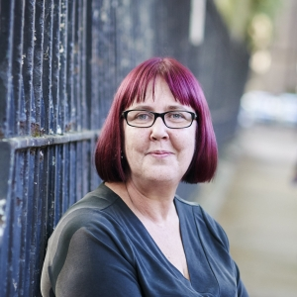
Insights from Kelly and Kaela
Kelly McBride, Deliberative Democracy Lead at TPX Impact
Kaela Scott, Director of Innovation and Practice at Involve

